Slide 1

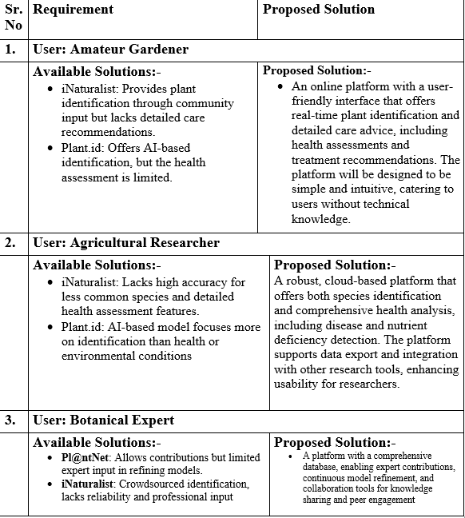
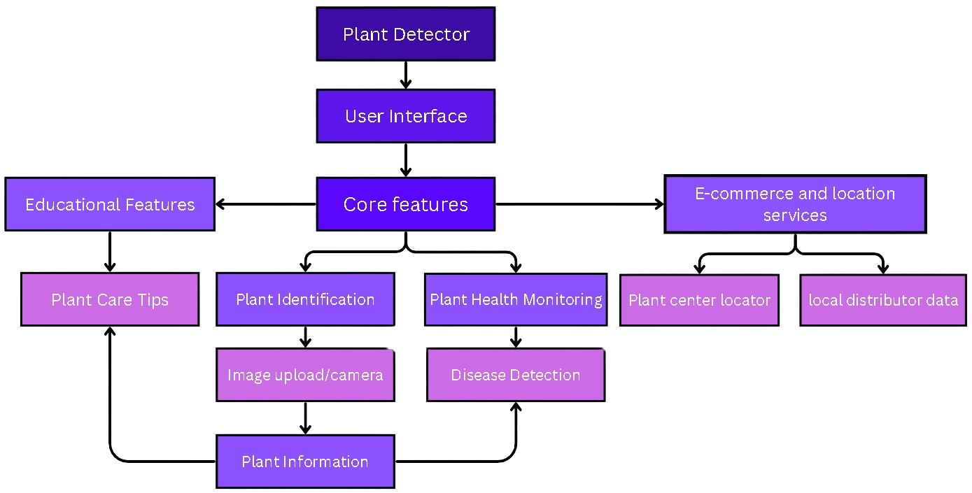
MIT SCHOOL OF COMPUTING
Class : TY AIA-3
Group Id: 116
DEPARTMENT OF COMPUTER SCIENCE & ENGINEERING
PLANT IMAGE DETECTOR SYSTEM
Shruti Thorat , Sujal Hande , Kartik Devkar , Om Talekar.
Faculty Guide:
Prof.Rashmi Tundalwar
Proposed Architecture/ Diagram:
What User Says : I need to identify plants quickly and accurately in the field. It should be easy to use, even for someone who is not tech-savvy. I need to know the plant species, its health status, and any potential issues like diseases or pests. | What User Thinks: Can I trust this tool to provide accurate information ? Will it help me identify rare or less common species ? Will using this platform save me time compared to traditional methods ? How easy is it to operate while working in the field ?
What User Does: Provides feedback on usability, accuracy, and any technical issues. Uses the platform to make quick decisions related to plant care, maintenance, or research. Compares the app’s output with traditional plant identification methods or personal knowledge.
User
What User Feels:
The potential for increased efficiency and accuracy in identifying plants.
If the platform is not user-friendly or gives incorrect information.
If the well, saving time and reducing the effort required for plant identification.
In making decisions if the platform consistently provides accurate and useful information.
Problem Statement
End-users, such as farmers, botanists, and gardeners, often face challenges in accurately identifying plant species and assessing their health in the field due to the limitations of existing tools, which may be complex, require internet connectivity, or lack accuracy in diverse environmental conditions. There is a need for a simple, That provides quick and reliable plant identification and health assessment to enhance decision-making and reduce frustration during fieldwork.
Proposed Solution
Develop a user-friendly platform to provide accurate, real-time plant identification and health assessment. The platform should function properly, offer an intuitive interface for non-technical users, and be designed to work effectively in various field conditions, ensuring reliability and easy to use for farmers, botanists, and gardeners.
Scope and Feasibility
Scope: Create a platform that provides plant identification and health assessment for non-technical users such as farmers, botanists, and gardeners. The platform will feature an intuitive interface, be accessible on multiple devices, and perform reliably in diverse field conditions.
Feasibility: The platform is feasible with current machine learning and image recognition technologies. Existing plant image datasets can be utilized to train models that operate offline. The platform will be designed for usability across devices, ensuring it meets user needs and environmental challenges.

